Slide 1

SPAM EMAIL DETECTION
45 DAYS INTERNSHIP / INDUSTRIAL TRAINING PRESENTATION
NITTTR CHANDIGARH
MR. AMRENDRA SHARAN
JASHANDEEP SINGH
A25305223102
BTECH CSE (AI/ML)
AMITY SCHOOL OF ENGINEERING AND TECHNOLOGY

Slide 2
INSTITUTION PROFILE
NITTTR Chandigarh (National Institute of Technical Teachers Training and Research) was established in 1967 by the Government of India to train teachers of polytechnics and engineering institutes.
The institute conducts teacher training programs, develops technical curricula, creates e-learning content, and offers consultancy to educational and government bodies. It also carries out research, organizes workshops, and supports skill development and digital learning initiatives.
NITTTR provides:
Teacher training programs
M.Tech/M.E. postgraduate courses
Curriculum design and consultancy
E-learning content and MOOCs
Workshops and skill development programs

Slide 3
SPAM EMAIL DETECTION
OBJECTIVE
Objective 1: Classify Emails as Spam or Ham
Objective 2: Maximize Detection Accuracy While Minimizing False Positives
Objective 3: Deploy a Real-Time Prediction System

Slide 4
PROBLEM STATEMENT
Email is a widely used communication method, but the rise in spam messages creates security risks and reduces productivity.
Spam emails often include phishing links, fraud attempts, and unwanted promotions.
Machine learning–based classification can improve detection reliability and adapt to new spam patterns.
The goal is to build a model using text preprocessing, feature extraction, and ML algorithms for efficient, real-time spam detection.

Slide 5
Tools & Technologies Used
Languages, Frameworks
Python 3.x - Primary programming language for data science implementation
Streamlit - Web application framework for deployment and creating interactive UI
NLTK (Natural Language Toolkit) - Framework for natural language processing tasks
Databases
CSV Files - Dataset storage (spam_ham_dataset.csv)
IDEs / Platforms
IDLE - Development environment for experimentation and model training
Git - Version control system for code management
Machine Learning & Data Science:
Scikit-learn - Machine learning algorithms (Naive Bayes, Logistic Regression, SVM)
Pandas - Data manipulation and analysis
NumPy - Numerical computing and array operations
Joblib - Model serialization and persistence
Natural Language Processing:
NLTK - Tokenization, stop word removal
TF-IDF Vectorizer - Feature extraction from text (Term Frequency-Inverse Document Frequency).
Visualization:
Matplotlib - Data visualization and plotting
Seaborn - Statistical data visualization and confusion matrix generation

Slide 6
SOFTWARE USED & REQUIRED TO RUN (WITH VERSION)
Software / Library | Version (Recommended) | Purpose
Python | 3.9 / 3.10 / 3.11 | Core programming language
pandas | 1.5.x or 2.x | Data loading and manipulation
numpy | 1.23+ | Numerical operations
scikit-learn | 1.2+ | ML algorithms (SVM, NB, LR), preprocessing, evaluation
nltk | 3.8+ | Text preprocessing (stopwords, stemming)
joblib | 1.2+ | Model serialization (saving/loading)
matplotlib | 3.6+ | Visualization (confusion matrix, accuracy plots)
seaborn | 0.12+ | Enhanced plotting (heatmaps, bar plots)
streamlit | 1.23+ | Web app framework for real-time spam prediction interface

Slide 7
HARDWARE USED
Component | Recommended Spec | Purpose / Justification
CPU | Intel i5 | Handles text processing and ML model training
RAM | 16 GB | Allows for smooth data loading, TF-IDF vectorization, and training
Storage | At least 500 MB free | For dataset, model files, and dependencies
Display | 720p or higher | To run and view Streamlit UI comfortably

Slide 8
MINIMUM REQUIREMENTS
Component | Minimum Spec | Notes
CPU | Dual-core processor | For running the Streamlit app and light ML tasks
RAM | 4 GB | Might be slow for training; OK for predictions
Storage | ~200 MB | Enough for model and vectorizer files

Slide 9
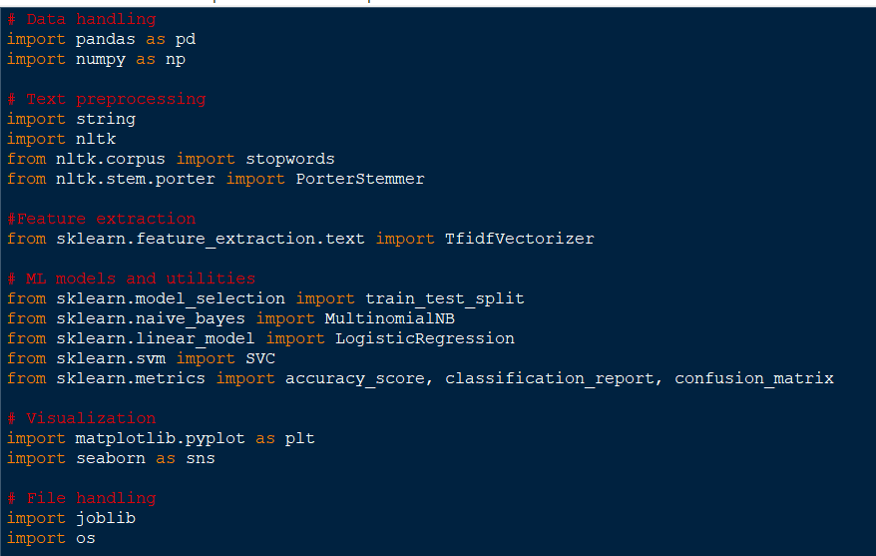
LIBRARIES

Slide 10
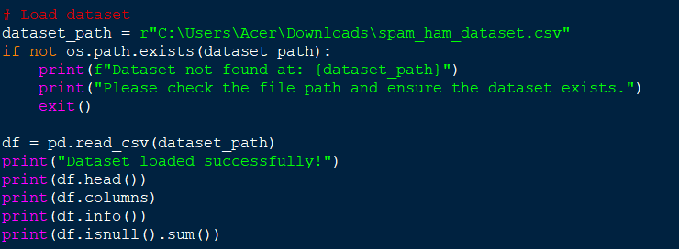
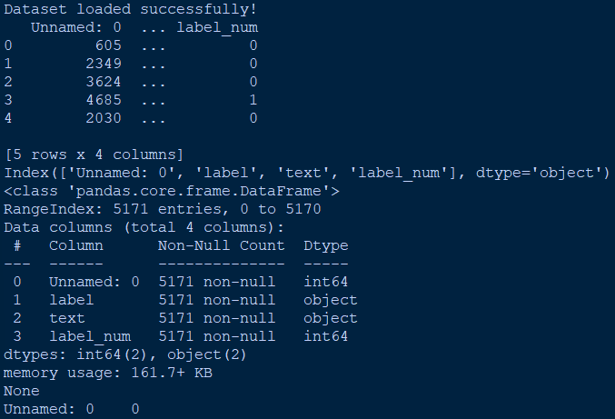
DATASET

Slide 11
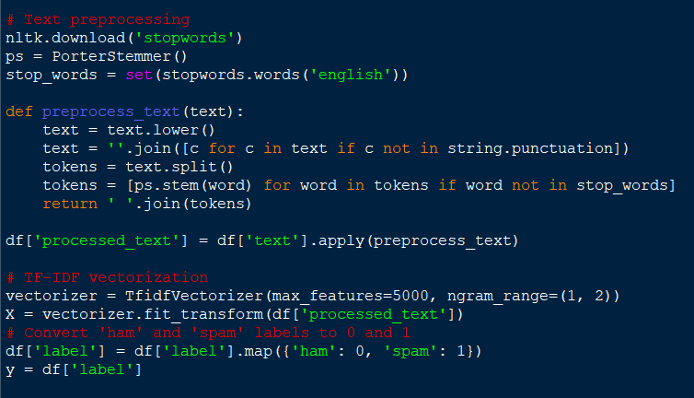
TEXT PROCESSING

Slide 12
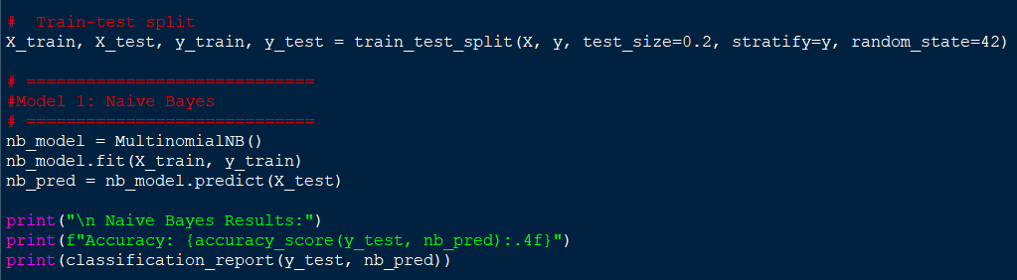
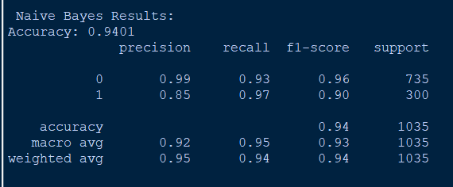
ML MODELS

Slide 13
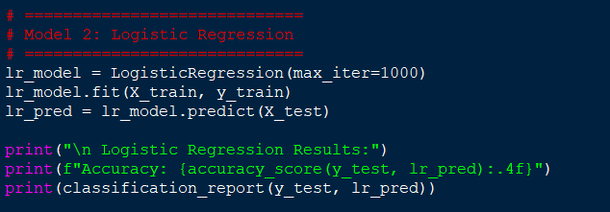
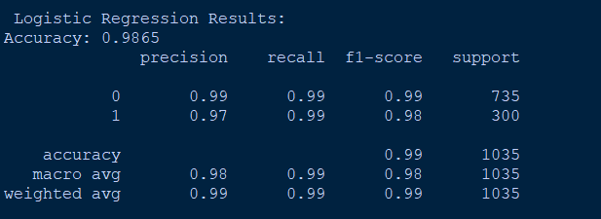

Slide 14
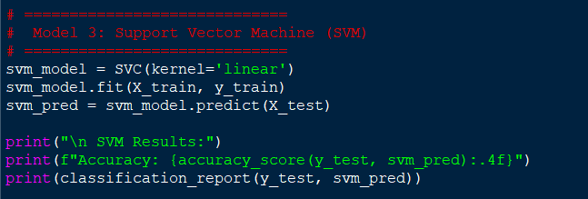
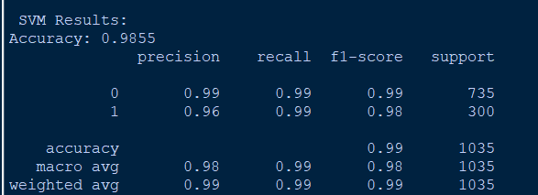

Slide 15
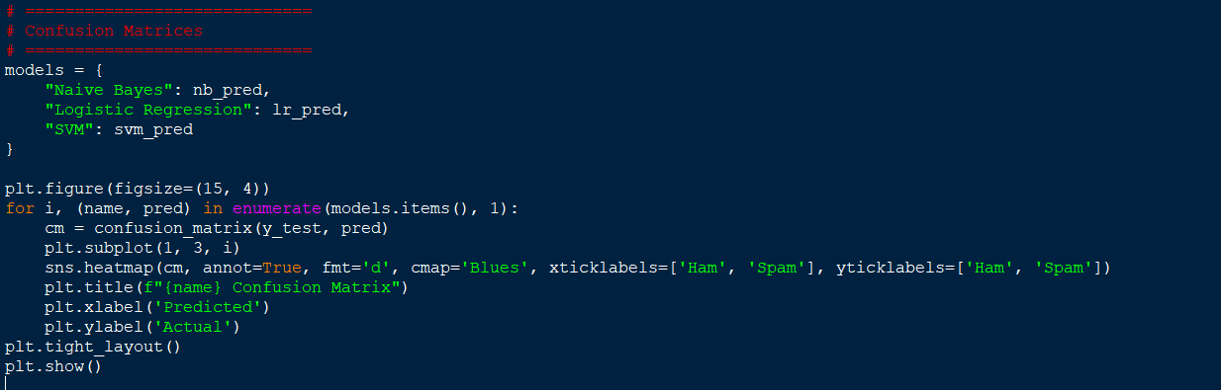
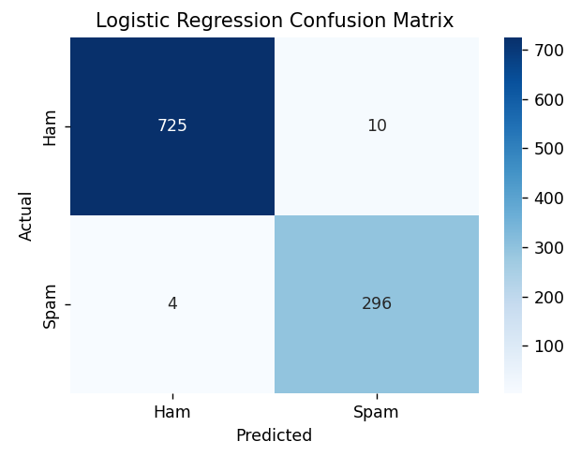
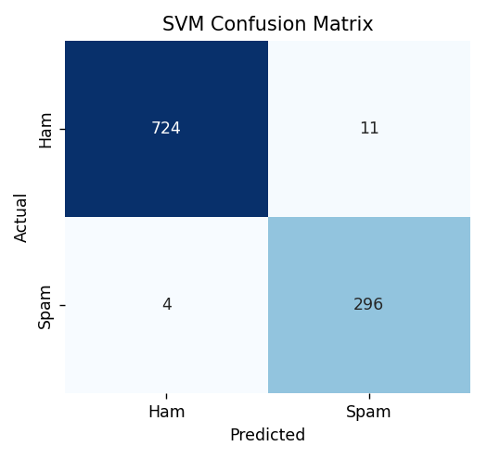
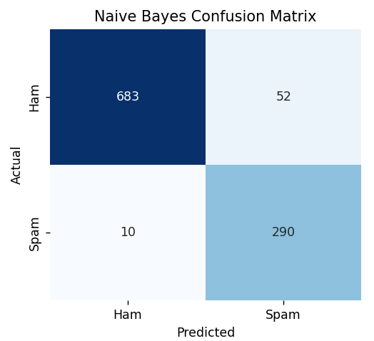
CONFUSION MATRIX OF MODELS

Slide 16
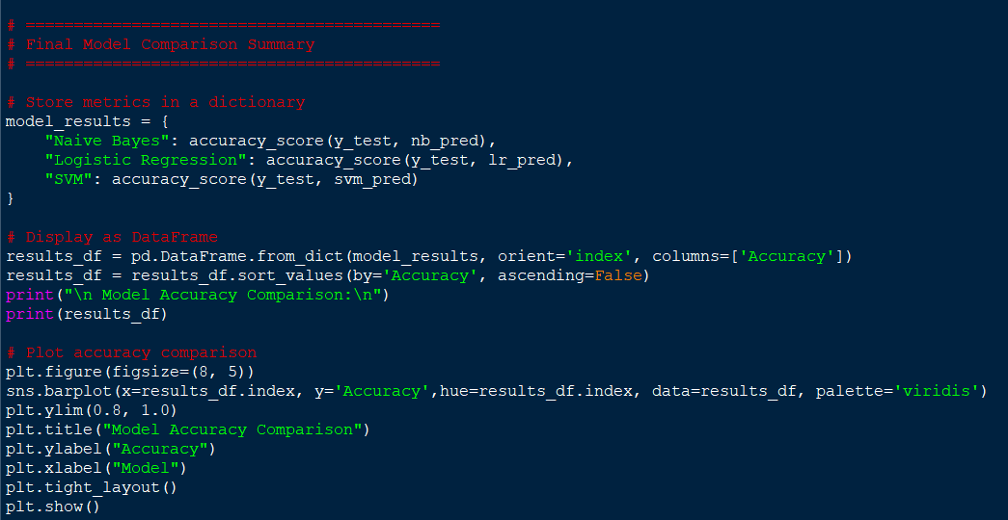
CAMPARISON OF MODELS

Slide 17
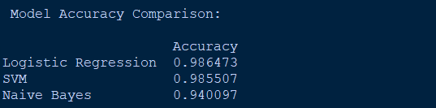
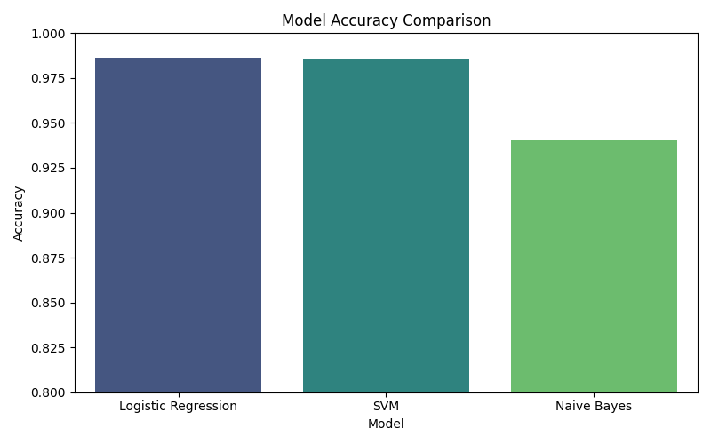

Slide 18
CHALLENGES AND SOLUTIONS
Challenge 1: Understanding Text Preprocessing
Issue: Initial difficulty in understanding why multiple preprocessing steps are necessary
Solution: Experimented with different preprocessing combinations and observed their impact on model performance, leading to better understanding of each step's importance.
Challenge 2: Model Selection
Issue: Uncertainty about which algorithm to use for the final deployment
Solution: Implemented multiple models, compared their performance systematically, and selected SVM based on accuracy and reliability metrics.
Challenge 3: File Path Management
Issue: Model loading errors due to absolute file paths
Solution: Implemented relative path handling and comprehensive error messages to ensure smooth deployment across different environments.
Challenge 4: Balancing Theory and Practice
Issue: Absorbing theoretical concepts while maintaining hands-on practice
Solution: Applied each concept immediately through small projects and exercises, reinforcing learning through practical implementation.

Slide 19
LEARNING OUTCOMES
Professional Skills Developed
Problem-Solving: Breaking down complex data science problems into manageable steps
Code Organization: Writing clean, maintainable, and well-documented code
Project Management: Planning and executing projects from conception to deployment
Communication: Documenting work and presenting technical concepts clearly
Industry Exposure
Real-world applications of data science in urban planning
Importance of geographical data analysis
Interdisciplinary applications of machine learning
Industry best practices and standards

Slide 20
FUTURE SCOPE
Improve accuracy using deep learning models like LSTM or BERT.
Explain predictions using tools like LIME or SHAP for transparency.
Real-time email filtering by integrating with email services (Gmail, Outlook, etc.).
Enhance text processing with better cleaning methods like lemmatization and spell correction.
Deploy the application online so it can be accessed by users through a browser.

Slide 21
THANK YOU

